Slide 1
Social Earth
Project By
Raghavi Kirouchenaradjou
Menita Koonani
Divya Priya Emmanuel

Slide 2
Problem Statement
It is a busy world where there is no time to even notice a child who needs a positive change, a homeless man in street suffering from cold weather or a blissful river spoiled by chemical oil flow
Our application provides a virtual environment which enables us to contribute to our society. The social responsibility of an individual is to give back to the world just as it gives to us. The purpose of the application is to thrive global community that lifts humanity and enhances the resources on which all life depends. It aids each individual who are part of our application community to empower decisions that create social, environmental and economic benefits for everyone by providing a platform.

Slide 3
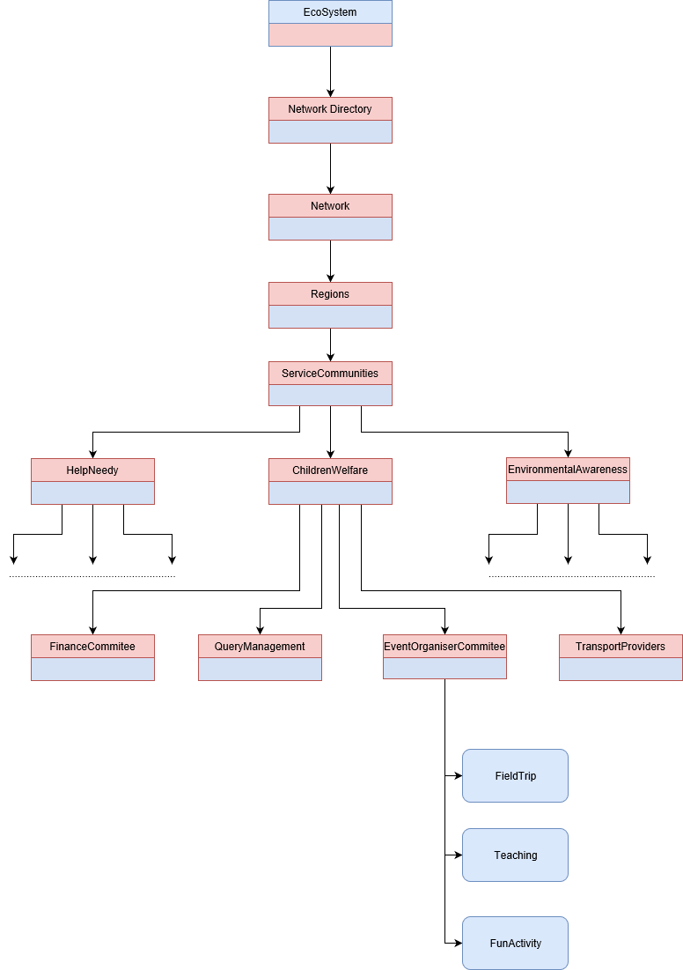
Rough Object Model

Slide 4
Main Innovative Idea Incorporated
Though people are ready to volunteer for social awareness activity, one of the main reason to hesitate is because of TRANSPORT facility !!
Our application provides transport facility using Google API technology which aids user to participate events on time and prevents excuse regarding travelling
Yet to add more ideas…….

